Slide 1






VCSE Partnership Round Table
Slide 1

Slide 2
NHS England
Neighbourhood Health Framework
Summary & Planning
Slide 2

Slide 3
Neighbourhood Health Framework
NHS 10-Year Plan Recap - Hospital to Community
Integrated Neighbourhood
Teams:
MDTs of health, social care, VCSE, etc, inc. new/ expanded roles. Lead on prevention, underpinned by geonomics and single patient record.
Neighbourhood Health
Centres (120 by 2030):
MDT One-stop shops, open 8am-8pm six days per week. Diagnostic, post-operative, rehab, weight-management, social/ lifestyle needs.
Urgent Care in the Community:
Split from A&E. Patients seen remotely, in people’s homes or via Neighbourhood Health Centres. Ability to book UEC appts by 2028.
Expand UCR, virtual wards and ICT (Step-Up/ Step-Down).
Reduce ED attendances, bed days in 2027.
End the 8am scramble:
000’s more trained GPs and on-line advice & guidance via NHS App. Bring back Family Doctor. Same-day access to 90% of urgent patients by March 2027.
Redesigned Outpatient Services:
PIFU via NHS App for clinically-appropriate pathways. SPOAS for 10 High-Volume specialities. 25% of acute outpatient referrals diverted by 2027.
Expanded role of Pharmacy:
Prescribe independently, manage LTCs (e.g. treatment of obesity, high blood pressure/ cholesterol). Support programmes for screening/ vaccines. All underpinned by AI.
NHS Dentistry:
Prioritising urgent care and CYP. 3-year tie-ins for NHS trainees. Water fluoridation schemes. Aligned to Neighbourhood Health Centres.
Care Planning:
95% of people with complex LTC to have coproduced Care Plan by 2027 – available on NHS App & Single Patient Record
Severe Mental Illness:
Development of 24/7 neighbourhood care models. 100% national coverage of Assertive outreach. Focus on mental health inequalities.
Dedicated Mental Health
Emergency Departments:
£120m to create 85 new MHEDs. Walk-in access, accept EMAS conveyance & meet 4-hour RTT.
Personal Health Budgets:
Doubled by 2028, 1 million by 2030 & universal for ‘all who would benefit’ by 2035
Slide 3
Slide 3

Slide 4


Neighbourhood Health Framework
Vision
Improve health outcomes & reduce inequalities
Deliver more personalised, convenient, joined up care
Reduce pressure on hospitals and care homes
Cut waste and duplication
Help the NHS meet national performance targets
The National Neighbourhood Health Framework was published on 17th March 2026.
Within Leicestershire, Northamptonshire & Rutland, our care current models cannot meet projected future demand.
Neighbourhood care models are now seen as the vehicle to:
Alleviate the increasing pressures across primary, community and UEC services,
Meet the rising needs of patients with frailty and LTC, and,
Address inequalities in a systematic way.
The National Neighbourhood Health framework sets out its own vision as described opposite…
Slide 4

Slide 5
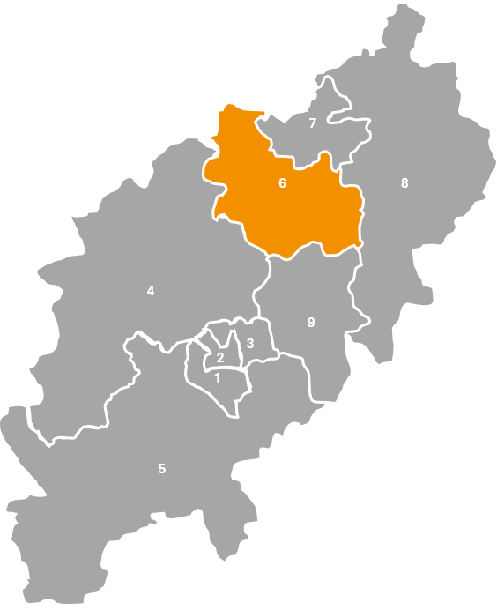
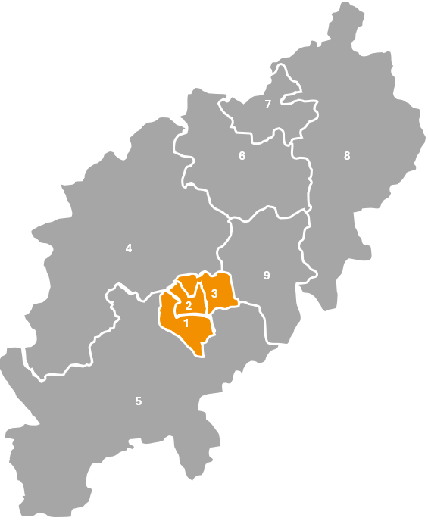
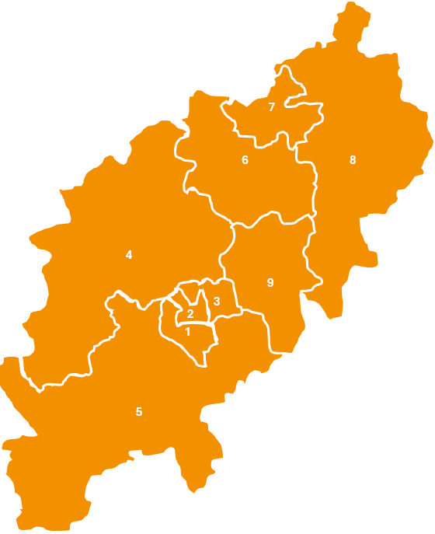







Neighbourhood Health Framework
Delivering Neighbourhood Care
Single Neighbourhood Providers
Likely sub-contracted from Primary Care organisations, and designed to offer new services in single neighbourhood footprints that are required for that specific local community (and not already contracted via GP contracts).
Multi-Neighbourhood Providers
Used where it makes sense to deliver services for ‘aligned populations’ on a wider scale than single neighbourhoods. NHSE approximates populations of c.250,000 – and may be mapped to urban/rural areas or local authority footprints.
Integrated Health Organisations
Offers appropriate providers a ‘whole population health budget’ to deliver care for a ‘geographically-defined population’. The IHO provider would adopt responsibility for meeting the outcomes, and managing the risks for that patient population, within the defined budget.
Slide 5

Slide 6
Neighbourhood Health Framework
Integrated Health Organisation Contracts
IHO providers take on the ‘whole population risk’ for a defined population across a geography.
Not to be confused with Lead Provider arrangements, which may manage funding for a sub-set of services, pathways and cohorts.
IHO providers take on the ‘whole health budget’ for their defined population. They then take responsibility for planning, resource allocation, meeting health outcomes and delivering care efficiencies as well as good patient/ staff experience.
IHO contract holders will develop decision-making infrastructure to shift the balance of spend out of acute sector and into the community.
NHSE will be testing the IHO contracts using the first tranche of Providers. However, they envisage IHO contract holders to sub-contract one/many ‘Multi-Neighbourhood’ providers, who (in turn) work with a set of ‘Single-Neighbourhood’ Providers + GP practices.
IHO contract-holders must take responsibility for data-driven needs assessments across their designated populations, as well as have strong clinical leadership (with bias towards General Practitioners) and accountability frameworks, professional oversight governance structures to ensure quality of care and evidence-based practice.
Slide 6

Slide 7
Neighbourhood Health Framework
Three-Year Reform Agenda
Reform Agenda One: Improved services for routine healthcare
Increased GP access via enhanced digital tools and increased Out-of-Hours services.
Empower GPs by stripping bureaucracy, introducing new technologies, and incentivising proactive population health management.
Improved access to Primary Care diagnostics and strengthening the role of pharmacy as ‘first contact’ to manage demand.
Reform Agenda Two: Improve Proactive Care
Commence Integrated Neighbourhood Health Teams, applying NHSE Best Practice guides for Frailty.
Grow Core Community Health services (including Women’s Hubs) to reduce wait times.
Transform Outpatient Care, introducing SPOAs for at least 10 specialities (with strong alignment to General Practice).
Standardise data-sharing between Neighbourhood & Acute teams.
Reform Agenda Three: Deliver better alternatives to acute care
Expand Urgent Community Response services.
Increase capacity of Virtual Wards to avoid unnecessary acute admissions.
Increase Intermediate Care capacity, in partnership with Local Authorities.
Explore alternatives to Hospital/ A&Es for people with mental health needs.
Slide 7

Slide 8
Neighbourhood Health Framework
10 Key responsibilities for systems
1. Produce a Local Neighbourhood Health Plan (2027-28)
Describe collective ‘place’ leadership, design and delivery. Plans need to be grounded in local need.
2. Define local outcomes and measures
Need to cover ‘whole-life course’ and include health, social care & VCSE.
3. Coordinate the full partnership at place
Ensuring plans and services are organised around people, not organisations
4. Embed prevention and proactive care
Use linked data and risk-stratification to anticipate need and prevent escalation
5. Oversee delivery against 5 National Goals
Must be aligned to Medium-Term Plans and local trajectories.
See Appendix One
6. Drive integration to cut waste and duplication
Apply a strong ‘digital’ approach (SPOAs, Shared information Systems, access to services via phone/ online as well as in person)
7. Reduce pressure on acute services
Expand neighbourhood-based alternatives. Move appropriate outpatient activity to neighbourhoods and improve discharge coordination
8. Adopt National Archetypes
Embed enabling conditions at place level. Agree common outcomes/ metrics. Apply incentives. Ensure joint strategic commissioning.
9. Steward the Neighbourhood Estate vision locally
Planning for Neighbourhood Health Centres as ‘community front doors’. Co-locate primary care, community, LA and VCSE.
10. Ensure genuine community engagement and coproduction
Ensure Health & Wellbeing Board members are working alongside residents are partners, to shape priorities and measures
Slide 8

Slide 9
Neighbourhood Health Framework
Immediate changes to be made (2026-27)
Develop Transformation Plans around neighbourhoods
Agree Neighbourhood footprints around natural communities
Agree plan to develop INTs for high-priority cohorts (with devolved budgets)
Reduce non-elective admissions and bed days, via neighbourhood UEC, rehab & reablement
Develop plans for transformed elective pathways, via devolved budgets for reduced RTT
Devolve budgets for greater Provider/ Partner ownership of outcomes
Improve access to GPs, ensuring GMC contracted core hours + new Urgent access requirements
Confirm Better Care (Pooled) Funding arrangements (inc. increase to ICB contributions)
Increase access and reduce
wait times
Establish data-sharing arrangements for robust patient identification & evaluation
Improve Primary-Secondary care interface via Red-Tape Challenge
Slide 9

Slide 10
LNR Integrated Care Board
DRAFT Neighbourhood Health Plan
Summary & Development
Slide 10

Slide 11
LNR Draft Cluster Neighbourhood Health Plan
Timeline for Neighbourhood Health Plan
Development of Draft Neighbourhood Plan
Formal Engagement
Refinement & Feedback
Consolidation
Sign-off & Publication
January 2026
August 2026
February 2026
March 2026
April
2026
May
2026
June
2026
July
2026
Draft to West Executive Place Board
26/02/26
Draft to West Place Board Workshop
24/03/26
Draft to Joint Health & Wellbeing Board Workshop
19/05/26
Sign-off at North/ West Health & Wellbeing Boards
24/06/26
Slide 11

Slide 12
LNR Draft Cluster Neighbourhood Health Plan
LNR DRAFT Cluster Neighbourhood Health Plan
Delivery Models
Frailty
Primary Care
CYP
Community Services
Urgent Care
Aging Well Programme
New Care Models Programme
CYP Single Provider Model
Family Hubs
Standardising Community Services
System UEC Programme
(UCR SPOA)
Frailty MDTs already in place (national exemplar)
Bolster with Older Adult MH and specialist Geriatrician
Pilots for Neighbourhood GP access + management of LTC
(Wellingborough & Rural South)
CYP Single Provider Model already exploring what INT would look like for this cohort
Commencing with MSK and Dietetic services:
Data Baselining exercise,
Specification Review
Explore MSK SPOA
2026-27 UEC Strategy:
Integrated Neighbourhood Health Model.
24/7 UCR capacity.
Expansion of Frailty SDEC
Slide 12

Slide 13
Integrated Neighbourhood Teams (INTs)
INTs will bring together different professionals and partners to work side by side to support people.
They will know their neighbourhoods inside out, and can tailor care to what matters for local people
They will deliver assessment,
care planning, coordination,
And follow-on support.
“By 2027, 95% of people with complex needs should have a Shared Care Plan”
NHSE has asked for an initial focus on:
Frailty, those who need end-of-life care.
People with multiple LTC.
Children & Young People.
People with Cancer.
LNR Draft Cluster Neighbourhood Health Plan
Integrated Neighbourhood Teams (Northamptonshire)
Integrated Neighbourhood Team Maturity Framework
Level One – Foundational: Early multidisciplinary working, developing neighbourhood identity, initial use of shared data, basic risk stratification, and emerging links with VCSE and social care.
Level Two – Developing: More consistent MDT working, shared caseload discussions, improved digital information sharing, proactive pathways beginning to take shape (e.g., frailty, CYP, mental health), and strengthened partnership working.
Level Three – Maturing: Integrated teams with shared planning and delivery, routine proactive care, embedded population health management, neighbourhood-based access models, joint workforce planning, aligned community services, and co-designed escalation pathways.
Level Four – Advanced/ Optimised: Fully coordinated neighbourhood delivery with seamless digital integration, shared workforce and estates models, expanded community diagnostics and specialist outreach, 24/7 neighbourhood urgent and crisis support, and consistently improved access, outcomes and experience across all priority areas.
Integrated Neighbourhood Teams in Northamptonshire will deliver a set of shared functions, including:
Proactive identification of need,
Coordinated multi-disciplinary care,
Personalised support planning,
Rapid escalation,
Seamless links to community, acute and VCSE sector partners.
INTs will be developed in phases, using the ‘Maturity Framework’ (opposite). Phase One will focus on:
Frailty (via Aging Well programme)
CYP (via Single Provider Model)

Slide 14
LNR Draft Cluster Neighbourhood Health Plan
Integrated Neighbourhood Teams
One Joined up team
Same day support
Proactive care
Clear points of contact
Personalised Care Plans
Care beyond clinical need
Close to home
A fair experience
More integrated working
Less duplication
Good advice channels
Strong, local relationships
Good career development
Support for decision-making
Sustainable workload
Positive, collaborative culture
Through Neighbourhood working, our residents will experience…
Through Neighbourhood working, our staff will experience…
Slide 14

Slide 15
LNR Draft Cluster Neighbourhood Health Plan
Next Steps for NHFT
Considering current/emerging work through Neighbourhood lens now (to avoid repeating/ re-building work later)
Adult Community Care Delivery Pathway
Children & Young People’s Care Delivery Pathway
Mental Health, Learning Disabilities & Autism Care Delivery Pathway
Baseline 1st tranche of SDC services (MSK and Dietetics) + Specification Review.
Instigate preparations for increased Care Planning (+ measurement approach for 95% target).
Consolidate 2025-26 UEC Contract Variation + confirm/ commence 2026-27 UEC expansion.
Establish appropriate contribution to INTs/ Neighbourhood Health Centres.
Where possible, decide on most appropriate team structure by neighbourhood footprint, by service.
Complete due diligence & contract negotiations for Single Provider Model.
Confirm Commissioning & Procurement Strategy for Single Provider Model.
Assess readiness to plan care at Population Health level (not just deliver commissioned services)
Embed in-reach arrangements to existing/emerging Women’s Hubs and Family Hubs.
Establish appropriate contribution to INTs/ Neighbourhood Health Centres.
Confirm response to DfE’s Best Start in Life Strategy.
Confirm response to new SEND White Paper reforms.
Plan and implement appropriate Older Adult Mental Health input to Frailty MDTs under Aging Well Programme.
Establish vision/ proposals for any expansion of 24/7 Mental Health UEC alternatives.
Establish appropriate contribution to INTs/ Neighbourhood Health Centres.
Where possible, decide on most appropriate team structure by neighbourhood footprint, by non-CMHT services.
Slide 15

Slide 16
NHFT Care Delivery Pathways
Our services

Slide 17
Mental Health and LDA Pathway
Mental Health Inpatients:
Mental Health Community Pathway
Psychology Services
Adult Inpatient Mental Health Wards – BWH & SMH; Section 136
Community Mental Health Teams (CMHTs)
Crisis Houses
Eating Disorders Service
UCAT – Urgent Care Assessment Team
ALMHS Acute Liaison Service
Complex PTSD
Learning Disability Services:
Adult Community Teams for people with LD (CTPLD)
Homelessness Provision
Liaison Psychiatry Older People (LPOP)
AAATT Service
Adult LD Short Breaks
Dementia and Delirium
Integrated Response Hub
Perinatal MH and Maternal Loss
Transforming Care
Crisis Response Unit
Op Alloy
Talking Therapies
Intensive Support Team (IST)
Meadowbank
Community Recovery Team
Personality Disorder Hub
Community Swift Response Team
Individual Funding Team
IPS Countywide
Specialist Perinatal MH Service
N-Step
Older People’s Mental Health Services & YPD
Community Forensic Team
Liaison and Diversion
Young People's Dementia
MH Treatment Requirements
Offender Personality Disorder
Older Adult CMHTs
Reconnect Service
Memory Assessment Service

Slide 18
Children & Young People Pathway
Specialist Services
Mental Health Services
Universal Services
Community Paediatrics
CAMHS Community (Core and Connect)
School Aged Immunisation Service
ADHD/ASD
CAMHS Live
West 0–19 Service
LAC Physical Health
CAMHS Inpatients (The Den and The Burrows)
North Best Start in Life and Thriving in Life Service
Community Children’s Nurses
CAMHS Intensive Outreach Team
Infant Feeding Team
Children’s Continence
CAMHS Crisis
Healthy Lifestyles Team
Care and Treatment of Children at Home
LAC Mental Health
Thriving Families Team
Family Ambassador Service
Nurturing Families Team
Special School Nursing
Community Eating Disorder Service (The Brambles)
Speech and Language Therapy
Paediatric Psychology Team
EHCP SALT Service
Mental Health Support in Schools
Occupational Therapy
Children Wellbeing Practitioners
Physiotherapy
Youth Offending Services
Referral Management Centre
Participation and iDiscover

Slide 19
Adult Community Services
Urgent Community Response Services
Community Inpatient Services
Rapid Response and Virtual Ward– West and North
Community Beds – Brackley, Corby, Danetre, Hazelwood, Spinneyfields
Urgent Step-Down Service – West and North
RIBU – Turn Furlong
Virtual Clinical Care Team
Specialist Palliative Care Services – Inpatient and Community
NHFT Single Point Of Access
Specialist Community Services
Specialist and Community Nursing Services
Community Brain Injury Service
Specialist Dentistry
Community Nursing - West and North
Dietetics (ACS and CYP)
Podiatric Surgery
Continence Services (ACS and CYP)
Community Therapy Services
Sexual Health & HIV Services
Heart Failure Nursing Service
Diabetes MDT
MSK Service
Parkinson's Disease Specialist Nursing Service
Paediatric Diabetes
Hand Therapy Service
Multiple Sclerosis Nursing Service
Diabetic High-Risk Foot
MSK Triage Hub
PCN Age Well - West and North
Diabetic Retinal Screening
Speech & Language Therapy
Admiral Nursing Services
Patient Contact Centre
*Not all our services are county wide, with some providing different offers across North and West councils

Slide 20
NHFT Care Delivery Pathways
Current VCSE collaboration and Neighbourhood plans

Slide 21
Current VCSE Collaboration
Hospital at Home is a co-produced alternative for mental health admissions in times of crisis. Support is delivered by Mind via contract with MHNC and NHFT.
Hospital at Home works to prevent admissions to hospital by providing wraparound support at home. Works with crisis team and current care team.
From a Voluntary sector perspective- the service has introduced the following. A volunteer pathway which provides telephone calls , reassurance, signposting and resources, to those on the waiting list for ADHD diagnostic assessment.
This is co- managed by us and the NHFT Volunteer team.
A community asset pilot in collaboration with Northants Carers. This provides support, advice, sign-posting and self-directed interventions/strategies.
The Integrated Response Hub – Opened in March 2020 and is staffed by VCSE and NHFT together. The IRH Model was fully co-produced.
Staff are encouraged to work with the caller to find a resolution to the need without organisational or operational boundary, ensuring that every contact with the Hub focuses on the goal to improve an individual’s Hope, Control and Opportunity in relation to their mental wellbeing. In our busiest 24 hours we supported 509 callers.
Accommodation Concern
NHFT commissions debt, benefits and housing advice from Accommodation Concern. This is in place until 31st March 2027.
There are embedded workers within the integrated response hub, CMHTs, crisis cafes, and at both hospitals. Teams routinely refer or navigate service users and carers to this service. We have seen an increase in referrals for benefits in the past 6 months since the changes to benefits were announced.
NHFT are supporting implementation of online feedback through IQVIA.
Crisis Cafes - Drop-in service run by a mental health expert and MIND support worker, these cafes support 212 individuals a month on average.

Slide 22
Current VCSE Collaboration
Activate - CAMHS, Northamptonshire Saints, Lowdown, Restart, Frank Bruno, Sports4Fitness
‘Activate’ is a 12-week occupation focused treatment group for young people with low mood and social anxiety. Age range is 14 – 17 years old. The first 6 weeks are in partnership with the Saints Foundation using a practical application of behavioural activation linked to their sports values programme. CAMHS staff also provide weekly psychoeducation sessions including coping strategies to build confidence and independence in managing emotions. Lowdown and Restart attend to explain their services and provide 2 parent sessions. The second 6 weeks take place at a variety of community venues with sessions for Activate linked to their own wellbeing programmes to support discharge planning e.g. Frank Bruno, Sports4Fitness, and Lowdown.
CAMHS Inpatients – NYA Advocacy, Animals in Mind, Yoga
- NYAS advocacy service offers a session a week across both wards, offering advocacy support to CYP on the wards. NYAS offer CYP individual sessions if they wish as well as attending the Young voices count group every Wednesday on the ward. NYAS cover the Burrows in the morning and the Den in the afternoon.
- Animals in Mind visit the ward once a month. This service has proved to be a favourite amongst the YP given the wide range of animals they bring.
- Inpatients also have a yoga instructor who attends the wards on a Tuesday, which YP enjoy as it helps them to relax.
11-19 Thriving in Life
Joint NHFT, Youth Works, and Service Six service. It is the new approach to 11-19 wellbeing service in the North with a blended school nurse and youth work approach to delivering public health outcomes.
CATCH 360
Partnership between NHFT CATCH (part of Community Children’s Nurses) and 3Sixty – Specialist Children’s Nurses deliver 3 clinics per day in 3 different locations Kettering, East Northants, and Wellingborough for children 5 years and under who are acutely unwell.
MH Digital Front Door.
Currently in the planning process and not yet finalised, but with view to final plans in February 2026. Intention to develop a collaborative MH digital front door.

Slide 23
Current VCSE Collaboration
Specialist Dental Services/Homeless organisations
Extended Duties Dental Nurses (EDDNs) are in contact the Hope Centre, the Rough Sleepers Team, Groundworks Trust, Encompass Charity, Daylight Centre Fellowship to provide OHP/OHE and dental advice.
MSK Community Assessment Day/Various
Day scheduled for end January 2026, to deliver physiotherapy in a setting with access to a range of other services, including Spring Social Prescribing, Age UK, Arthritis UK, and Trilogy Gyms, amongst other health and social care providers.
Specialist Dental Services/GRT community
Outreach programme has been extended to the Community Safety & Engagement Team and the Community Development Workers to organise a health fair to support the Gypsy, Roma and Travellers’ community.
MSK Physio/Northamptonshire Sport
Developing a working link with Northamptonshire Sport to routinely share their information to the MSK patient cohort.
Specialist Dental Services/Libraries
Sessions delivered at Libraries, communities centres, education settings and play groups in areas of deprivation, to promote good oral hygiene to children and adults with additional needs.
HIV Services/CHIVA
Working together to provide young people with HIV with access to peer support
HIV Services/TRADE
Working with TRADE who support under-represented communities, including lesbian, gay, bisexual and trans people (LGBTQ+), people living with HIV, and racialised communities in the East Midlands.
ACS/Various
Internal ‘Day a Year to Volunteer’ initiative to allow staff to volunteer with local community groups, e.g. Food Banks.

Slide 24
Current VCSE Collaboration
Community Nursing/Spring
Regular engagement sessions to build collaborative working and information sharing and clinician and patient level, improving patient access to social prescribing services where appropriate.
Specialist Palliative Care/Hindu Temple
The SPC team are linking with the Hindu temple in Wellingborough and attending wellbeing events in local care homes.
Inpatient Settings/Food Banks
All community inpatient settings now have local Food Bank collection points in each site to support people in their local communities.
Community Nursing/Various
Community Nursing liaise regularly with a range of organisations to provide patients with additional support. These include Admiral Nursing, Dementia UK, the Alzheimer's Society, and Northamptonshire Carers, as well as local voluntary groups, community libraries and churches.
Inpatient Settings/Bright Sparks
Support to patients in Spinneyfields and Hazelwood ward, encouraging rehabilitation and socialising through singing groups, and local artists will be painting murals in the Robin Unit in Spinneyfields.
PCNs/Northamptonshire Carers & Age UK
Primary Care Network staff regularly engage with Northamptonshire Carers and Age UK to support patients to access a range of services within their local communities.
UCR/Age UK
Age UK support UCR with visits and then follow up those patients with assessments around wider support. In December they provided food packages that were provided to appropriate UCR patients.

Slide 25
Neighbourhood Plans
Urgent and Emergency Care Delivery
Development of a proactive care model in Community Nursing linked to Neighbourhood pilot areas.
Review and planning of Long-Term Conditions management with Neighbourhood pilot areas.
Increased levels of diagnostics delivered in community settings.
Full integration of Community Nursing into Neighbourhoods areas.
Delivery of Long-Term Condition management through integration with the Neighbourhoods.
Specialist Community Delivery
Standardise core service provision as defined in Standardising Community Health Services.
Engage with New Models of Care Neighbourhood pilot areas.
Engage in the development of new obesity service models.
Identify gaps and delivery mechanisms to ensure greater integration into Neighbourhood areas.
Develop new integrated Neighbourhood models of delivery across a range of organisations.
Inpatient Services
Review clinical pathways to ensure alignment with Neighbourhood offers.
Develop robust step up/step down processes for inpatient settings within Neighbourhoods areas.

Slide 26
Neighbourhood Plans
0-19 Services geographical alignment
The North BSiL and TiL teams are aligned to Neighbourhoods already. In the 0-19 West we are undertaking the changes to align from April onwards.
Launch of new CYP System transformation workstream
Develop initial plans for a) CYP provision at Place (common for all Neighbourhoods) and b) priority CYP focus actions for any particular Neighbourhoods
Oversee the delivery of Neighbourhood developments for CYP – noting that ‘CYP’ is not just one cohort
Align CYP Neighbourhood developments with developments and strategies for all age groups.
MHST
Wave 13 commenced in September 2025 with further waves expected on a yearly basis to ensure that we have 100% coverage across the County by 2029-2031.

Slide 27
Opportunities for the future
Urgent and Emergency Care Delivery
Expand Age UK support for picking up and dropping off items for patients
Help for patients who can’t manage their home environment (cleaning, small tasks, basic maintenance)
Support groups for people with long‑term conditions
Groups for carers and families to share advice and support
Basic technical support for housebound patients to help them access online exercises and stay connected
Volunteers to sit with patients safely waiting for ambulances when no clinical input is needed
Specialist Community Delivery
Telephone befriending, advice, and general support
Group sessions focused on keeping well and promoting self‑care
Delivery and collection of exercise equipment for people with low‑level needs
Volunteer driving to help people get to appointments
Inpatient Services
Increased activity support for patients who are confused (e.g., jigsaw puzzles, simple meaningful activities)
Social support around discharge, such as help with cleaning, small home maintenance tasks, and basic food packages
Transport offers specifically to support safe and timely discharges

