Slide 1



Crisis and Resilience Fund:
Building Resilience & Tackling Poverty Across West Northamptonshire
Notes:
This is a walkthrough of the Crisis and Resilience Fund, what it means in practice, and what it means for partners.
Some of the later slides, particularly the checklists, are quite detailed. They’re there as a resource for you to work through afterwards.
We’d like to take you through why this matters, how the approach is changing, what the fund is aiming to achieve, and how this translates into the delivery model going forward.

Slide 2
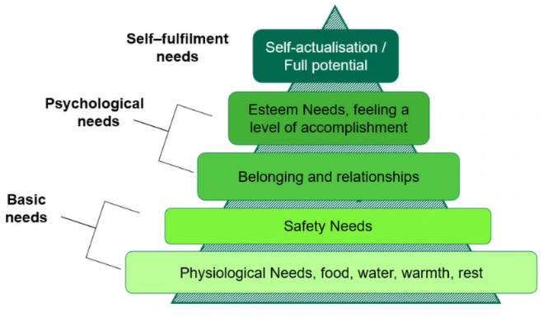
Why This Matters: Poverty and Health Are Closely Linked
Poverty doesn’t sit in one service; it affects everything
When finances are under pressure, the impacts are wide-reaching:
Basic needs at risk
Food, heating, housing and essentials become harder to maintain
Mental health pressures increase
Ongoing stress, anxiety and uncertainty
Physical health deteriorates
Delayed treatment, worsening long-term conditions
Access to services reduces
Barriers to transport, digital access and early help
Resilience is weakened over time
Small shocks become crises more quickly
What this means for services:
Demand increases across multiple systems
Issues present later and are more complex
No single service can resolve these challenges alone
If we want to reduce crisis, we must address the financial drivers early, and in a joined-up way
Notes:
For most of us, this is what we see every day in the work that we do.
When finances are under pressure, the impacts don’t sit in one place. They show up across people’s lives, whether that’s food, housing, energy, health, or access to support.
We see people making difficult decisions day to day; delaying bills, skipping meals, struggling to maintain stability across multiple areas at once. Alongside that, we see the wider impacts; on mental health, on physical health, and on people’s ability to access help early.
This isn’t about highlighting anything new; it’s about reminding ourselves of the scale and nature of what we’re responding to. Because if we’re going to design support that works, we need to look at this not just from an emotional perspective, but in a way that allows us to respond consistently, fairly, and effectively across the whole system.
That means understanding that poverty doesn’t sit within one service, and that no single organisation can resolve it in isolation. We see; demand increasing across multiple services, people presenting later (often when situations are more complex), and more pressure on frontline services as a result.
If we want to reduce crisis, we need to address the financial drivers earlier, and in a more joined-up way.

Slide 3
Poverty resilience is shaped by the wider determinants of health
The impacts highlighted on the previous slide are driven by a range of interconnected factors, not one single issue.
Poverty Resilience
Access to Financial Advice & Support
Strengthened Education & Skills
Community Resilience & Support
Access to Affordable, Quality Housing
Income Maximisation & Financial Inclusion
Energy / Utility Support & Advice
Debt & Budgeting Support
Employability Programmes
Access to Affordable, Nutritional Food
Access to Affordable Childcare
Support with Mental Wellbeing
Tenancy Sustainment
Living Wage Employment
Transport Access
Digital Inclusion
No single service can address these issues alone; this requires a joined-up system.
Notes:
Building on that are the wider determinants of financial wellbeing.
Again, this is the reality we’re already working within. This visually reinforces the sheer range of factors that can impact someone’s financial situation. This is only a small selection, but you can see it spans; income, debt, housing, food, energy, skills, employment, access to services, and wider wellbeing.
When we talk about financial hardship, we’re not talking about one issue, we’re talking about a combination of interconnected pressures. And that’s why no single service on its own can resolve this.
This is about recognising the scale and complexity of the system we’re operating in, and being realistic about what it takes to respond effectively. It’s also why a joined-up approach isn’t just helpful, it’s essential.

Slide 4
What Good Looks Like in West Northamptonshire
A system that supports people early, connects services, and improves outcomes over time.
In West Northants, financial wellbeing should mean:
Early help, not just crisis response
Crisis Support that connects
One joined-up system
Real, measurable and sustainable, outcomes
Support leads to tangible improvements in financial stability.
Residents can access timely support before problems escalate.
Immediate help meets urgent need and links directly into longer-term support.
Services work together, with clear roles, pathways and referrals with no duplication.
Simple, accessible, person-centred support
Support is easy to access, consistent, and built around people’s real lives and needs.
This is not about creating new services, it’s about connecting what already exists and making it work as one system
Notes:
The next step is thinking about what a more effective system looks like in practice.
A lot of this already exists across West Northamptonshire. This is about bringing those elements together in a way that works more consistently for residents.
At its core, what we’re aiming for is a system that: supports people earlier, connects services more effectively, and improves outcomes over time.
That means; early help (not just responding at the point of crisis), crisis support that connects people into longer-term help (not a standalone intervention), and services working together as one system, with clear roles and pathways.
It also means that support should feel; simple to access, consistent, and built around people’s actual lives and needs, not around how services are structured.
Importantly, it’s not just about activity, it’s about outcomes. That is being able to say; people’s financial situations have improved, crises are reduced over time, and support is making a measurable difference.
This is not about creating new services, it’s about making better use of what’s already there, and connecting it in a way that works as a system rather than as separate parts. The good news is a lot of this is already in place locally, so the next step is to build on that.

Slide 5
Building on What We’ve Achieved Together
Across West Northamptonshire, significant progress has already been made towards this system
What we’ve already achieved
What’s already in place
£13.9m delivered to residents through over 500,000 awards
380,000+ households supported
Over £5m invested in VCSFE services
Strong community offers including welcoming spaces, larders and energy support
Strong VCSFE partnerships
Community-based delivery through hubs, outreach and trusted spaces
We already have the building blocks of a joined-up system
Multi-year funding and data insights
What this tells us
Strong partnerships are in place
There is a clear opportunity to go further
The next step
Strengthen coordination across services
Create clearer, more consistent pathways
Embed “no wrong door” approaches
Integrate financial, health and community support
Established advice and support services
The Crisis & Resilience Fund provides us with the opportunity to support this next step
Notes:
If that’s what good looks like, where are we now?
It’s important to recognise that we’re not starting from scratch. Across West Northamptonshire, a significant amount of support has already been delivered over the last few years. We’ve supported hundreds of thousands of households, delivered millions of pounds of support, and invested heavily in VCSFE provision and community-based services.
That has made a difference to residents, but at the same time, it’s important to be realistic about where we are. Due to funding constraints, changes in the National and Local political landscapes and responses to International disasters and crises, that support has often been reactive, inconsistent across the system, and not always fully connected.
While we’ve delivered a huge volume of activity, we haven’t always been able to consistently measure the longer-term outcomes of that support. There is a lot of good practice in the system, but we’re still some way from a fully joined-up, outcomes-led model.
What does put us in a strong position locally, is that over the last three years, we’ve taken a public health approach to anti-poverty. That means we’ve already started to shift towards prevention, towards earlier intervention, and towards more sustainable, longer-term support.
This is important, because it means we’ve already begun moving in the direction that ‘good’ requires. In practice, that has helped to mitigate some of the risks around funding cliff edges, build stronger local partnerships, and develop more sustainable approaches to support.
While we’re not where we want to be yet, we are already on that trajectory. And what the Crisis and Resilience Fund gives us is the opportunity to take that next step in a more consistent, structured and outcomes-focused way.

Slide 6
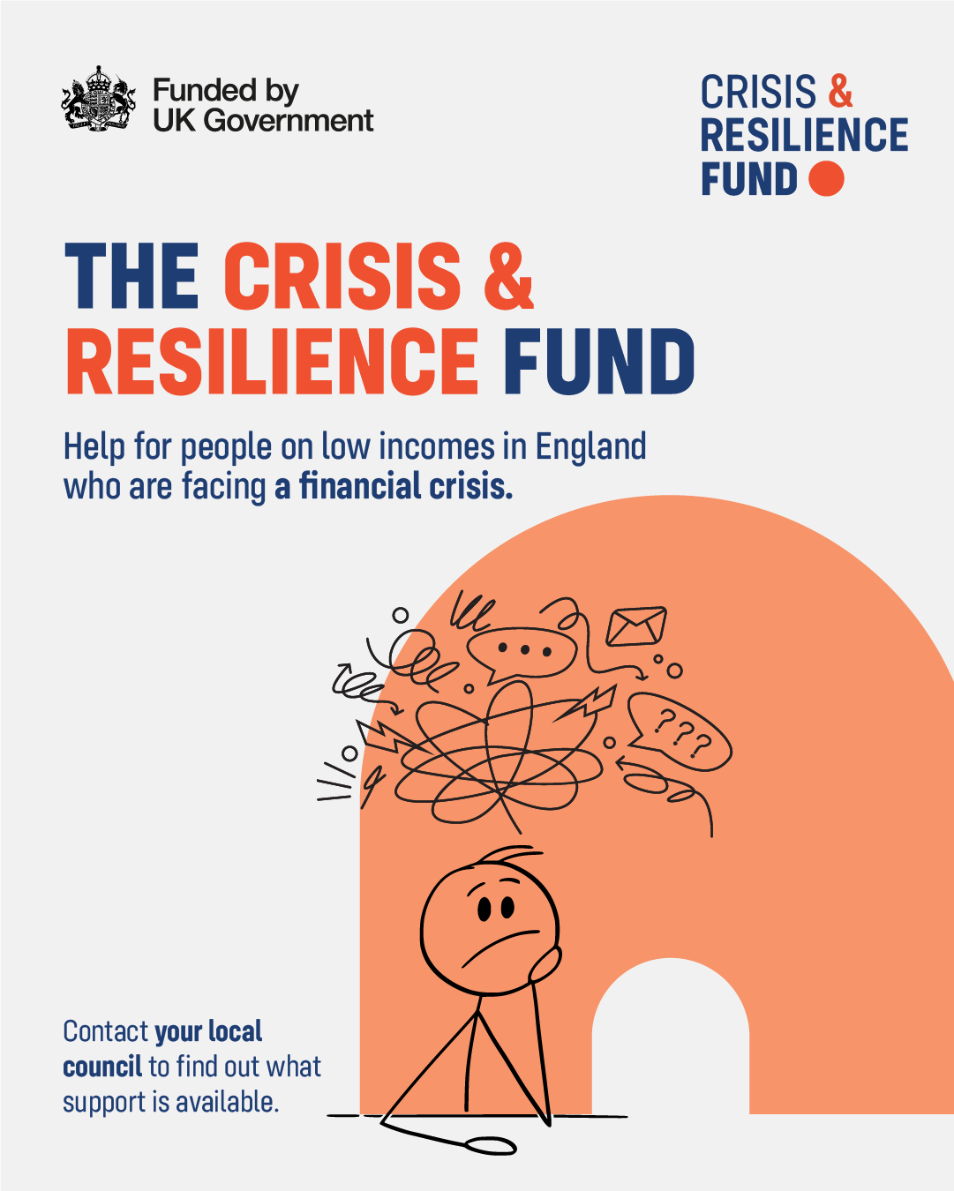
Introduction to CRF
What is the Crisis and Resilience Fund (CRF)?
3-year funding from Central Government.
£4.9m per annum in West Northamptonshire to provide:
  Support for low-income households who encounter a financial shock – CRISIS
  Activities and services that build financial strength for individuals and communities - RESILIENCE
Crisis Support
  Supports essential living costs, emergency items, and short-term financial aid for residents in need.
Resilience Services
  Ensure support not only provides relief but also promotes sustainable long-term outcomes.
Complementing Existing Services
  CRF works alongside existing statutory services, local advice partners, Housing Associations, VCSFE organisations and community groups to fill gaps efficiently.
Notes:
This is where it’s important to be clear about what the Crisis and Resilience Fund is, and the position we’re working within as a local authority.
The Crisis and Resilience Fund is a three-year programme from central government, providing £4.9 million per year in West Northamptonshire to support residents facing financial hardship, both at the point of crisis, and in building longer-term resilience.
While we do have flexibility to design the model around local need, the funding comes with national guidance, expectations, and required outcomes. We are required to demonstrate how funding is used, and critically, what outcomes it delivers for residents.
It’s also important to say clearly, this is not simply a continuation of, or replacement for the Household Support Fund. HSF was primarily a cost-of-living response focused on providing immediate support during a period of acute pressure.
CRF is a different programme. It brings together crisis support, resilience services, and community coordination, into a longer-term, more strategic approach that has financial resilience at its heart.
The expectation is not just that we respond to need, but that we demonstrate how support is helping to reduce repeat crisis, improve financial stability, and connect people into the right support over time. And that’s why the National model is structured around both crisis and resilience. Crisis support responds to immediate need, resilience ensures that support doesn’t stop there.

Slide 7
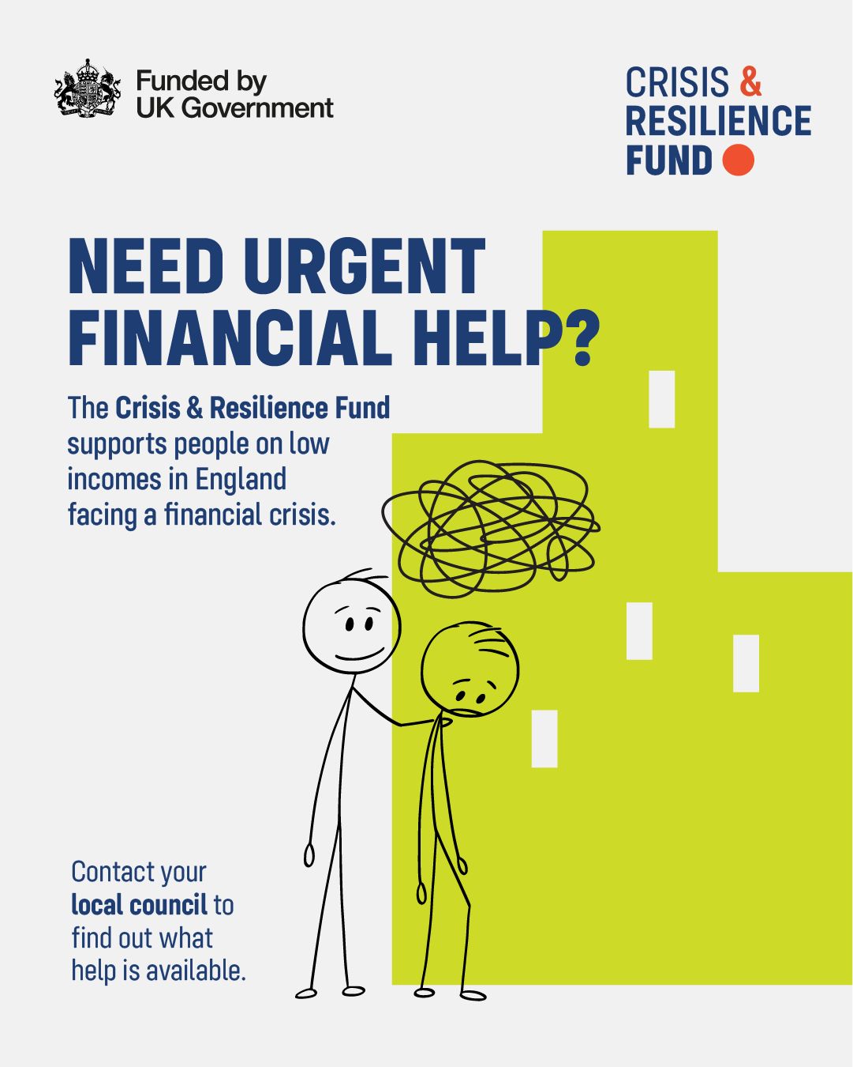
Crisis and Resilience Fund: A different funding model
Through CRF, funding is linked to real outcomes, showing how support improves people’s financial situation over time.
What this means nationally
Moving from short-term crisis help to preventing problems and building financial resilience
What this means for partners
More focus on collaboration, shared referrals, and being part of a wider network
What this means locally
What this means for residents
Services working together as one joined-up system, not in silos
Easier access to the right help, with support that looks at the full situation, not just the immediate crisis
Notes:
This slide sets out what that means in practice, and how the model operates differently as a result.
At a national level, the shift is from short-term crisis response to preventing problems and building financial resilience over time. Locally, that means moving away from services operating in isolation, and towards a joined-up system, where support is coordinated.
For residents, the aim is that support becomes easier to access, more connected, and focused on their whole situation, not just the immediate issue. And for partners, this means a greater emphasis on collaboration, shared referral pathways, and being part of a wider system rather than operating standalone.
The key shift here is from activity to outcomes, and from individual services to a connected system.

Slide 8
From Crisis to Resilience: Mandatory Strands
The Crisis and Resilience Fund introduces a strategic, preventative approach to reduce poverty-related crises over time.
Crisis
Immediate help for urgent needs
Prevention
Early intervention to stop poverty cycles
Long-term empowerment:
Resilience
This means:
Support doesn’t stop at the crisis
People should be supported into longer-term help
Services must work together, not in isolation
Wraparound support embedded in all actions
Crisis
Crisis Support Payments
Housing Payments
Resilience
Resilience Building Services
Community Coordination
Crisis Payments
Immediate support for urgent needs, cash-first where appropriate and linked to further support through referrals
Housing Payments
Housing Payments replicate the support previously provided through Discretionary Housing Payments but sit inside the CRF.
Resilience Services
Focus on reducing repeat crisis and improving financial stability, delivering measurable outcomes. Authorities must use a significant proportion of funding for Resilience Services.
Community Coordination
A new mandatory strand to build a joined-up local system, improving navigation, enabling warm referrals, and increasing visibility of support.
Notes:
Let’s consider how that is structured in the National guidance. This slide introduces the four strands that make up the Crisis and Resilience Fund.
These are set out in the national guidance, and they form the framework that we are required to deliver against locally. This structure isn’t something we’ve developed in isolation, it’s been directed nationally, and it underpins how the programme is designed.
The four strands are: Crisis Payments, Housing Payments, Resilience Services, and Community Coordination. Two of these focus on immediate crisis support, and two focus on longer-term resilience and system coordination.
All four are expected to work together as part of one connected approach, rather than as separate elements. And wraparound support is expected throughout, so that support doesn’t stop at the point of crisis.

Slide 9
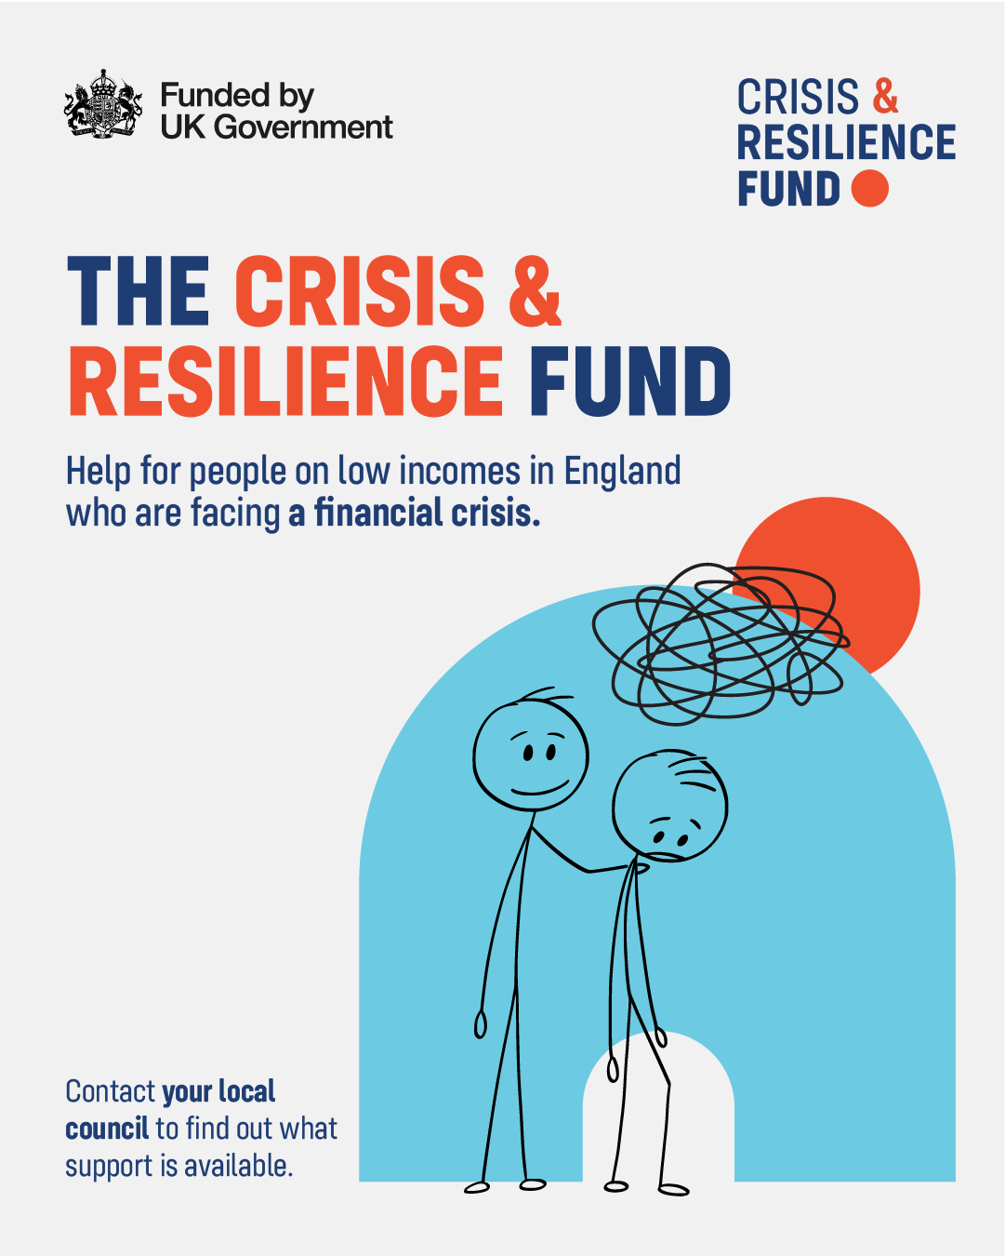
Crisis Support Payments (Delivered by WNC)
What is a crisis?
“A sudden and unforeseen event that has created an immediate risk to health, safety, or basic living conditions.”
Crisis support is for immediate, urgent situations only, not ongoing financial hardship.
Crisis support is short-term help that bridges the gap until longer-term support is in place.
What crisis support
provides
One-off, short-term support for essential needs
Cash-first approach by default, supporting choice, dignity and faster access to essentials
Costs must arise directly from the crisis
Support must be immediate and unavoidable
Delivered by West
Northamptonshire Council
All applications assessed by WNC internal teams
Decisions based on evidence and policy criteria
We call all applicants to understand their needs and tailor our offers of support.
Support awarded within 48 hours of receiving a complete, eligible application.
Role of partners
Recognise when a situation meets crisis criteria
Support residents to access the correct route
Provide context or verification where appropriate
Link residents into wider support
What this is not
Ongoing cost of living support
General low income or affordability issues
Routine or predictable expenses
Notes:
Starting with the first strand, Crisis Support Payments. This is one of the two elements delivered directly by West Northamptonshire Council.
To support this, we’ve developed a clear definition of what we mean by a crisis within this scheme. A crisis is a sudden, unforeseen event that creates an immediate risk to someone’s health, safety, or basic living conditions.
This is about urgent, immediate situations, not ongoing financial pressure or longer-term affordability issues.
There are a few key principles that sit behind this: Support must be immediate (DWP require that we issue support within 48 hours of a complete application). It follows a cash-first approach by default. And it is short-term support, designed to bridge the gap until more formal or longer-term support is in place.
This is not ongoing support, it’s a short, immediate intervention at a point of crisis.
All applications are assessed by WNC, and we take a consistent, evidence-based approach to that assessment. That includes checking applications against available data for fraud prevention & verification and contacting applicants directly to understand their situation.
That allows us to ensure that any support is person-centred, proportionate, and the most appropriate option available. We’ll also ensure that crisis support is not duplicating other support that is already available or more appropriate.
Just to bring that to life with a simple example of an application that we received:
A resident experienced a house fire, other statutory services provided temporary accommodation. A Crisis Support Payment was issued within hours to allow them to purchase essentials like clothing, food, and immediate necessities. That support was able to bridge the gap until insurance funding became available.
The role of crisis support here is very focused, it’s addressing that immediate gap, not providing longer-term relief. From that point, residents can then be supported into longer-term help, whether that’s housing advice, financial support, or help to rebuild stability.
So crisis support is the entry point, not the end of the journey.

Slide 10
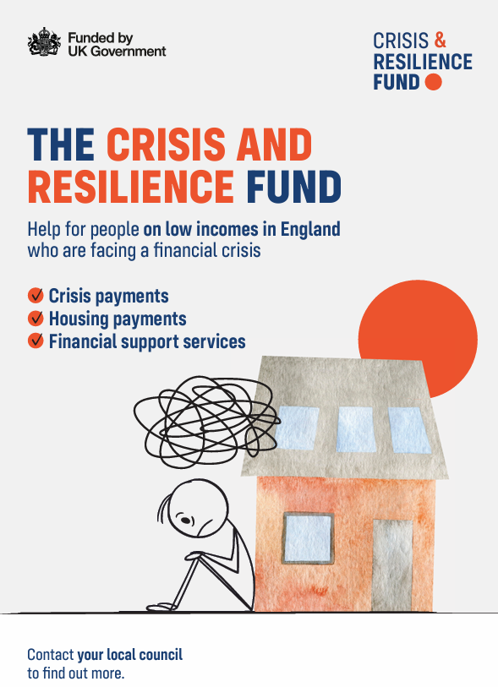
Housing Payments (Delivered by WNC)
Housing Payments build on Discretionary Housing Payments, now integrated within the wider CRF approach.
What this is
Financial support for housing costs, aligned to existing DHP principles
Supports residents receiving Housing Benefit or Universal Credit housing element
Now delivered as part of the Crisis & Resilience Fund
What it can support
Rent shortfalls and arrears prevention
Rent deposits, rent in advance, and moving costs
Support to remain in or secure suitable accommodation
Temporary financial shocks affecting housing stability
Key principles
Needs-based and case-by-case assessment
Aligned with trauma-informed and “no wrong door” approaches
Linked to wider support where needed (e.g. advice, income maximisation)
What this is not
Ongoing or indefinite housing support
Costs outside Housing Benefit / Universal Credit rules
Long-term affordability issues without a defined need
Housing Payments provide targeted, short-term support to stabilise housing situations and prevent escalation into crisis.
Notes:
The second strand delivered directly by WNC is Housing Payments.
This will be familiar to some, as it builds on the support previously provided through Discretionary Housing Payments. This is targeted financial support for housing-related costs, for residents who are already receiving Housing Benefit or the housing element of Universal Credit.
Housing Payments can be used to support situations such as rent shortfalls, rent arrears prevention, deposits or rent in advance, and helping people remain in, or secure, suitable accommodation. It can also be used where there has been a temporary financial shock that is putting someone’s housing at risk.
It is needs-based, assessed case-by-case, and focused on preventing housing instability or escalation into crisis. As with crisis support, this is not ongoing or indefinite funding, it’s designed to provide targeted, short-term support where it can make a difference.
This is not: a long-term solution to affordability issues, or support outside of Housing Benefit or Universal Credit housing rules.
From a partner perspective, the role here is to recognise when someone may be eligible, understand the types of situations this can support, and help residents to access the scheme where appropriate. If you’re working with someone struggling with rent shortfalls, at risk of arrears, or needing help to secure or maintain accommodation, this is a route to consider.
And as with crisis support, this should also link into wider support for example tenancy sustainment, income maximisation, or advice services. It’s not a standalone intervention, it’s part of a wider pathway.

Slide 11
Resilience Services
Resilience Services are about reducing repeat crisis by improving financial stability, not simply funding general wellbeing activity.
What Resilience Services are
Targeted support that helps residents move from crisis response to longer-term stability.
Services that address the financial drivers of hardship, such as debt, low income, benefit issues, energy costs, budgeting pressures and material deprivation.
Support that can show measurable impact against DWP outcomes.
A route into quality advice, practical help and casework where residents need more than a one-off payment.
What Resilience Services are not
General wellbeing, social or community activity without a clear financial resilience outcome.
One-off crisis responses (these sit within Crisis Support Payments).
Standalone signposting with no follow-up, referral pathway or measurable outcome.
Funding for activity that cannot show how it reduces hardship or future crisis.
Required outcomes include:
Reduced priority debt
Reduced material deprivation
Reduced need for emergency food aid
Income maximisation
Increased savings
Increased access to quality advice services
If a service cannot clearly evidence and report on these outcomes, it does not meet the CRF Resilience Services requirement.
Notes:
This is where the programme starts to connect much more directly with the support delivered by partners. And this is also where the expectations from DWP are very clear. Resilience Services are about reducing repeat crisis by improving people’s financial stability over time. This is not about general wellbeing activity, it’s about support that is clearly linked to financial resilience.
DWP have set out a number of required outcomes that we must be able to demonstrate through this funding. These include:
reducing priority debt,
reducing material deprivation,
reducing the need for emergency food,
increasing income,
increasing savings,
and improving access to quality advice.
These aren’t optional, they are the outcomes that WNC is required to evidence to access and retain this funding. It’s also important to say that DWP expect the majority of CRF funding to be spent on resilience services.
While crisis support is an important part of the programme, the longer-term focus is very much on prevention and stability. From a delivery perspective, this means that any service funded through this strand needs to be able to clearly show how it improves someone’s financial position, and how that impact can be measured.
It’s not enough to demonstrate activity alone, we need to be able to evidence what has changed for residents as a result of that support.

Slide 12
What Good Looks Like: Resilience Services
Good resilience support does not just tell people where to go; it helps them get there.
Person-centred and realistic
Warm, not passive, referrals
Financially focused
Joined-up across partners
Measurable and accountable
Support starts with the resident’s actual situation, not assumptions about what they should need.
Residents are actively connected to the right support, with consent, context and follow-up where needed.
Support links clearly to income, debt, housing stability, essential costs, budgeting or access to advice.
Services understand their role in the wider system and avoid duplication, gaps and “bouncing” residents between organisations.
Partners can show what changed for residents, not just how many people attended.
The aim is not to create more services in isolation.
The aim is to create clearer routes through the support that already exists and strengthen the gaps where needed.
Notes:
Let’s look at what good resilience support looks like in practice. This is not about creating new services in isolation, it’s about strengthening how support is delivered, and how services connect with each other.
At its core, good support doesn’t just tell people where to go, it helps them actually get there. That means support that is person-centred, starting with the individual’s actual situation, active rather than passive, with warm referrals instead of just signposting, and clearly linked to improving someone’s financial position.
It also means services working as part of a joined-up system, understanding their role, and connecting people into the right support where needed.
Importantly, it also means being able to demonstrate what has changed for residents, not just how many people have been seen or supported. The focus here is on: quality of support, connection between services, and measurable outcomes.

Slide 13

Driving Resilience Through a Three-Tier Model
Different residents need different levels of support. The tiered model helps us match need to the right type of help.
Tier 1: Specialist Casework
For residents needing structured advice or casework, including FCA-accredited money and debt advice, housing advice, welfare benefits, income maximisation and regulated support.
Tier 2: Money & Wellbeing Hubs
Place-based hubs where residents can access a consistent mix of support in trusted community settings.
Tier 3: Local Spokes
Smaller local access points and connected groups of support, helping residents access early help and move into hubs or specialist services where needed.
Cross-cutting principles across all tiers:
Same DWP reportable outcomes
Warm referral pathways
Clear roles and accountability
Consistent data and impact reporting
No wrong door into support
The tiers are not a hierarchy of importance; they are different parts of one connected system.
Notes:
This slide introduces our local delivery model for West Northamptonshire. This is how we’re structuring the system to bring together the different types of support we’ve talked about.
This model has been designed to maximise opportunities for residents and create opportunities for a wide range of partners to be involved in delivery. At its simplest, the model is based around three tiers: specialist casework, place-based hubs, and local access points.
The purpose of this model is to make sure that support can be tailored to where someone is on their journey. Some people will need more structured, in-depth support, some will need accessible, local entry points, and others may need a mix of both over time.
This allows us to match people to the right level of support, rather than trying to fit everyone into the same offer. It also creates opportunities for a broader range of organisations to be involved, recognising that different organisations bring different strengths, whether that’s specialist advice, community-based access, or practical support.
But at the heart, is not the tiers themselves, it’s the connections between them. For residents, the expectation is that they experience: smooth transitions between support, and a system that feels joined-up, rather than fragmented.
And that relies on strong referral pathways, clear roles across the system, and partners working together, not in isolation.

Slide 14
Tier 1: Specialist Financial Resilience Services
Tier 1 is for structured casework and specialist advice where residents need more in-depth support.
Who this includes
WNC internal resilience-building and money support.
FCA-regulated debt advice providers.
Welfare rights and income maximisation services.
Housing Associations and housing advice providers.
Energy debt / fuel poverty specialists.
Other quality-assured providers able to accept warm referrals for casework.
What Tier 1 must be able to do
Accept warm referrals from Crisis Support, hubs and spokes.
Provide structured support, not one-off signposting only.
Work with residents to address underlying financial hardship.
Track and report measurable outcomes.
Mandatory, reportable outcomes
Reduced experiences of material deprivation
Maximisation of individuals’ income
Reduced need for emergency food parcels
Reduction in priority debt
Increased access to appropriate and quality advice services
Increased savings
Tier 1 is where residents go when they need more than information; they need advice, advocacy or casework.
Notes:
This tier is for organisations delivering structured, regulated, in-depth support, where residents need more than information or short-term help. This is where people go when they need: advice, advocacy, or ongoing casework to resolve more complex issues.
This will include services such as debt advice and write-off, welfare rights and income maximisation, housing advice, and other specialist support linked to financial stability. The expectation within this tier is that support is structured, ongoing where needed, and focused on addressing the underlying causes of financial hardship.
This goes beyond signposting. It’s about working with someone over time to improve their situation. Tier 1 services are a key part of the wider system. They need to be able to accept warm referrals from crisis support, hubs and spokes, and where appropriate, refer people back into other support for ongoing help. This is a central part of how the system connects.
And as with all resilience services, support in this tier must be able to demonstrate the outcomes set by DWP, particularly around reducing debt, increasing income, and improving financial stability.

Slide 15

The Opportunity: CRF and Neighbourhood Health
CRF gives us a practical route to bring financial resilience into the wider ICB Neighbourhood Health model.
Neighbourhood Health is moving services towards:
More personalised, convenient and joined-up support.
Prevention and proactive care.
Reduced duplication across organisations.
Community-based access points.
Stronger partnerships between NHS, local authorities, social care, housing and VCSFE services.
What this means in practice:
Residents do not have to tell their story repeatedly.
Financial hardship is recognised as part of health and wellbeing.
Services can make active, warm referrals instead of passive signposting.
Community organisations are visible partners in prevention.
The system can respond earlier, before hardship escalates into crisis.
A hub should feel practical, welcoming and useful, not like another referral maze.
Notes:
Neighbourhood Health is part of the wider NHS and Integrated Care Board approach, bringing services together at a local, community level. The aim is to create more joined-up support, more preventative services, and easier access for residents, all based around local neighbourhoods. So rather than services being delivered separately, the focus is on bringing health, local authority, and VCSFE support together.
And this is where there’s a strong alignment with CRF, because CRF is focused on financial resilience, and financial hardship is a major driver of health and wellbeing outcomes. This gives us a clear opportunity to make financial support part of that wider, joined-up system rather than something that sits separately.
Another important element of this is that Neighbourhood Health comes with capital investment. Which means there is the opportunity to design and develop spaces and models collaboratively, ensuring that financial wellbeing support is considered as part of that design, rather than added in later.
This is still developing, and we’re not at a point where everything is in place. But the direction of travel is very clear, and it’s something we need to start planning for now. Over time, this is about moving towards more accessible, consistent, community-based support, aligned with how wider services are being delivered locally.
So from a partner perspective, this is: an opportunity to be part of a wider, integrated system, and to help shape how financial wellbeing support is delivered in those spaces.

Slide 16
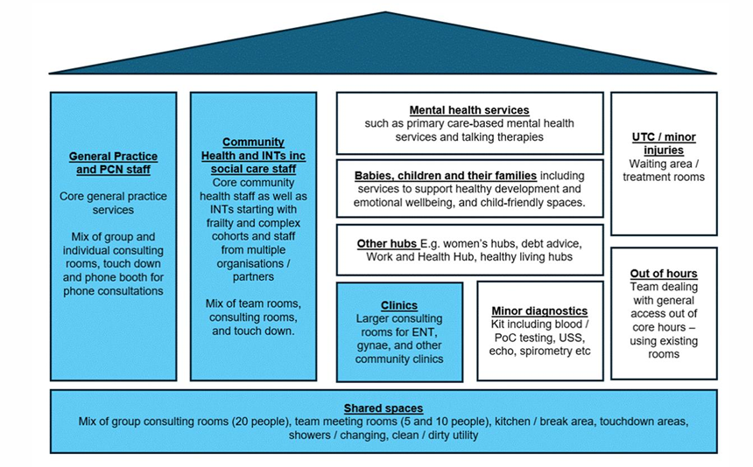
Where CRF sits in a Neighbourhood Health Centre
CRF strengthens this approach by ensuring standardised offer of money, debt, housing and practical support are part of the local neighbourhood offer.
This is the opportunity to make financial wellbeing part of neighbourhood prevention, not separate from it.
Notes:
This slide brings that concept to life a bit more and looks at where CRF sits alongside wider Neighbourhood Health delivery.
Rather than thinking of financial support as something separate, this is about embedding it as part of the wider neighbourhood offer. Alongside health, care, and community services, you would also see access to money support, debt advice, housing support, and practical help with everyday costs.
Financial wellbeing becomes part of prevention, not something that sits outside of it. For residents, that means they don’t have to seek out support separately, they can access help in one place, and their financial situation can be recognised as part of their overall wellbeing.
For services, it means stronger links between different types of support, more opportunities for warm referral, and a more coordinated response to need.
The opportunity is to ensure that financial resilience is built into that model from the outset, rather than added in later.

Slide 17
What Could a Money & Wellbeing Hub Offer?
A Money & Wellbeing Hub should be able to offer frequent access to a minimum of 5 core support services. Those activities in these services could include:
Money and debt
Debt advice
Budgeting support
Income maximisation
Benefit checks
Affordable credit / savings support
Housing and stability
Tenancy sustainment
Rent arrears prevention
Homelessness prevention
Housing Association support
Education and Skills
Affordable food and essentials pathways
Affordable furniture / white goods
Digital access and support
Health and wellbeing links
Mental wellbeing support
Gambling-related harm support
Substance misuse support
Social prescribing
Carer support
Navigation and referral
Warm referrals into Tier 1 casework
Supported access to Crisis Support
Clear pathways into local community support
Follow-up where appropriate
Practical help
Energy advice & accessing social tariffs
Affordable childcare
Transport costs
Domestic violence & coercive control support
Making your money go further
Financial Education
Everyday Costs
Employment support
Development of practical money-saving skills
Reduced priority debt
Reduced material deprivation
Reduced need for emergency food aid
Income maximisation
Increased savings
Increased access to quality advice services
All support must demonstrate and measure all the following outcomes:
The consistent offer matters more than the label. Residents should know what help is available, when, and how they will be supported to access it.
Notes:
This slide gives more detail on what could sit within a Money and Wellbeing Hub.
Initially, we would expect hubs to offer at least five core support areas (the headings in each box), plus navigation and referral support.
That does not mean every organisation has to deliver everything. It means that, collectively, the hub provides a consistent and accessible mix of support, so residents know what help is available, when it is available, and how they will be supported to access it.

Slide 18


Tier 3: Local Spokes and Community Access Points
Spokes are trusted local access points that connect residents into the wider resilience system.
What Tier 3 spokes are
Local groups, venues or partnerships offering accessible support close to where residents live.
Trusted community connectors that can identify need early.
Part of the wider CRF pathway, not standalone activity.
Minimum expectation
Tier 3 spokes should be a collaboration of at least two organisations who can provide and connect residents into at least three types of support, as outlined on the previous slide.
What makes it a spoke
Services do not all have to be in the same building.
Support should be conveniently accessible and joined up for residents.
There must be clear referral routes into Tier 1 and Tier 2 where residents need more complex or multiple forms of support.
Outcomes must still be reported against the same CRF requirements.
Tier 3 is about reach, trust and connection, making sure residents can enter the system through places they already know.
Notes:
Tier 3 is Local Spokes and Community Access Points. This tier is about trusted, community-based organisations, and for many, this is likely to feel the most familiar. These are the services that are already embedded in communities,
often acting as the first point of contact for residents.
The role of Tier 3 is early identification of need, accessible local support, and helping residents navigate into the wider system. What is different within this model is the expectation around partnership and connectivity. Rather than services operating independently, Tier 3 is expected to be delivered as a collaborative offer.
And the reason for that is to strengthen referral pathways, increase the range of support available to residents, and ensure people can access wraparound support in one place. To ensure residents are not just receiving one type of help, but are being supported across multiple areas where needed.
That does mean that partnerships need to be genuine, active, and designed around how services work together in practice. Not solely basing decisions on historic relationships, it’s about building partnerships where services are complementary, connected, and able to provide a coherent experience for residents.
From a resident perspective, the expectation is that support feels joined-up and seamless. That may not mean everything is in the same building, but it does mean services are easy to move between, well connected, and accessible in a way that makes sense locally.
Tier 3 is about building on what already exist in communities but strengthening how those services connect and work together.

Slide 19
Strand 4: Community Co-Ordination
Community Coordination is what makes the whole system work; connecting services so residents can access the right help at the right time.
What Community Coordination is
Building and maintaining a joined-up local support network
Enabling warm referrals across services, not just signposting
Making it easier for residents to navigate support
Improving visibility of what exists locally
Supporting services to work as one system, not in silos
How this overlaps with Resilience Services
Resilience Services deliver support outcomes
Community Coordination ensures residents can access those services
Both require:
Strong referral pathways
Partnership working
Clear roles across the system
We cannot deliver effective resilience services without effective coordination
What this is not
A separate programme running alongside services
General community activity without a role in the CRF pathway
A replacement for frontline delivery
Community Coordination is the infrastructure that turns good services into a functioning system.
Notes:
We’ve spent quite a bit of time on resilience services, due to the focus on outcomes, but it’s important not to overlook this strand, because it’s what enables the rest of the model to function.
Effective resilience services cannot be delivered without effective community coordination. There is a lot of overlap between the two. Resilience services are about delivering support and outcomes, whereas community coordination is about making sure people can access that support.
This includes things like building and maintaining partnerships, enabling warm referrals between services, improving visibility of what’s available locally, and helping both residents and services navigate the system more easily.
Without that coordination, we risk having good services that are difficult to access, poorly connected, or duplicating effort.
With it, we have a system that is: easier to navigate, better connected, and more effective overall.
This isn’t about creating a separate programme alongside everything else, it’s about the infrastructure that holds the system together.
While resilience services deliver the outcomes, community coordination is what makes those outcomes possible.

Slide 20
Working with Voluntary Impact Northamptonshire (VIN)
VIN will act as the connector between CRF and the VCSFE sector, supporting collaboration, development and sustainability.
Connecting organisations (“matchmaking”)
Supporting VCSFE organisations to form partnerships
Bringing together complementary services (e.g. advice + community access + practical support)
Helping build hub and spoke models, not isolated bids
Strengthening the sector
Supporting organisations to:
Understand CRF requirements
Develop their offer to meet outcome expectations
Build confidence in data, referrals and partnership working
Identifying and filling gaps
Working with WNC to:
Identify gaps in provision across the system
Engage organisations who may be able to step into those gaps
Support development where needed
Supporting long-term sustainability
For organisations not currently aligned to CRF:
Sharing alternative funding and grant opportunities
Ensuring no organisations are excluded from the wider system
Supporting a sustainable, resilient VCSFE sector
Not everyone needs to be ready on day one , this is a supported, phased approach
VIN is not an additional layer. It is the support mechanism that helps the system function and grow.
Notes:
This brings us to the role of our Local Infrastructure Organisation - Voluntary Impact Northamptonshire (VIN) within this model.
VIN’s role is as the enabler and connector for the VCSFE sector. This is not about adding another layer into the system. It’s about providing the support needed to help the system function effectively and grow over time.
This is a developmental approach, we’re not expecting everything to be fully formed from day one. VIN will play a key role in supporting organisations to understand the model, develop their offer, and build the partnerships needed to participate effectively.
In practice, that includes helping organisations connect and form partnerships, bringing together complementary services, and supporting the development of hub and spoke models.
As well as helping organisations understand CRF requirements, strengthen their offer where needed, and build confidence around things like outcomes, referrals and data.
Not everyone needs to be ready immediately. This is about building the system over time, with support in place to help organisations get to that point.
VIN will also work with WNC to identify gaps in provision, support organisations to step into those gaps where appropriate, and ensure the system develops in a balanced way.
The role of VIN is really to: support collaboration, strengthen the sector, and help turn a group of individual services into a connected system.
Importantly, this approach is about bringing organisations into the system, not excluding them. Even where services don’t immediately align to CRF, there is still a role in the wider system, and support available to develop over time.

Slide 21

What Community Coordination Looks Like in Practice
For residents
Clearer routes into support
Fewer hand-offs and repeated referrals
Access to the right help, first time
Support that connects across needs (money, housing, wellbeing)
For organisations
Clear understanding of where you fit in the system
More opportunities to partner and collaborate
Support to develop and strengthen your offer
Access to shared learning, networks and opportunities
For the system
Better coverage and fewer gaps
Reduced duplication
Stronger referral pathways
Improved outcomes and reporting
A more sustainable, coordinated support landscape
This is about making the most of what already exists and connecting it in a way that works for residents.
Notes:
The next slide considers what community coordination looks like in practice.
At its simplest, this is about making the most of what already exists and connecting it in a way that works better for residents. For residents, this should mean clearer routes into support, fewer hand-offs between services, and being able to access the right help first time.
It also means support that is connected across different needs, whether that’s money, housing, or wider wellbeing. For organisations, this means: a clearer understanding of where you fit within the system, more opportunities to collaborate, and support to strengthen and develop your offer.
It also creates access to shared learning, networks, and opportunities rather than working in isolation. And at a system level, it helps us to: reduce duplication, fill gaps in provision, strengthen referral pathways, and improve the overall impact of support.
This isn’t about creating something new it’s about making the existing system more coordinated, visible, and effective. And ultimately, it means moving from: a collection of good individual services to a system that works together to deliver better outcomes for residents.

Slide 22
References
Crisis and Resilience Fund Guidance - GOV.UK
Trussell & Policy in Practice recommendations for CRF
Why Cash First? – Independent Food Aid Network
Cash first and the Crisis and Resilience Fund – Cash first but not cash only
Crisis and Resilience Fund: Supporting people with food
Notes:
We have also included links to further information about some of the National Guidance and Policy Influences
Future communications will come from a dedicated CRF email address hosted by VIN.
We ask that all CRF-related queries are directed to this inbox to ensure they are managed and responded to efficiently. Emails sent to WNC or individual contacts at VIN may be treated as duplicates or redirected to the CRF inbox for action.
The key message to leave you with is that this is about building a connected, outcomes-focused system together, not delivering services in isolation. And there is a role for a wide range of organisations within that, at different stages, and in different ways.

